Slide 1

Generative Adversarial Networks in Computer Vision
Shree Gowri Radhakrishna
Computer Science Department, San Jose State University

Slide 2
A review of,
Generative Adversarial Networks in Computer Vision: A Survey and Taxonomy
ZHENGWEI WANG,
QI SHE,
TOMÁS E. WARD
https://arxiv.org/abs/1906.01529

Slide 3
Objective
Introduce GAN
Understand challenges of GANs and propose improvements
Look at various GAN architectures from 2 perspectives:
Architecture-variant
Loss-variant

Slide 4
Architecture of GAN
Two Deep Neural Networks
Discriminator
Generator
Discriminator optimized to distinguish real vs fake images
Generator creates images to fool discriminator

Slide 5
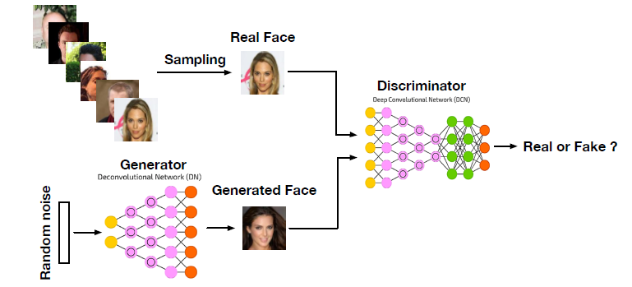
Architecture of a GAN

Slide 6
Applications of GAN
Applications:
Image generation
Image to image translation
Image super resolution
Image completion
Advantages over tradition Deep Generative Networks:
Produce better outputs than DGMs
Can train any type of network
No restriction on size of latent variable

Slide 7
Challenges in GANs
High quality image generation
Diverse image generation
Stable training.

Slide 8
Two broad classification of GANs
Architecture – variant GANs
Focus on architectural improvements to solve issues
Network Size and Batch Size
Loss – variant GANs
Focus on modifying loss function to improve performance
Normalization and regularization

Slide 9
Architecture Variant GANS
Fully-connected GAN (FCGAN)
Laplacian Pyramid of Adversarial Networks (LAPGAN)
Deep Convolutional GAN (DCGAN)
Boundary Equilibrium GAN (BEGAN)
Progressive GAN (PROGAN)
Self-attention GAN (SAGAN)
BigGAN

Slide 10
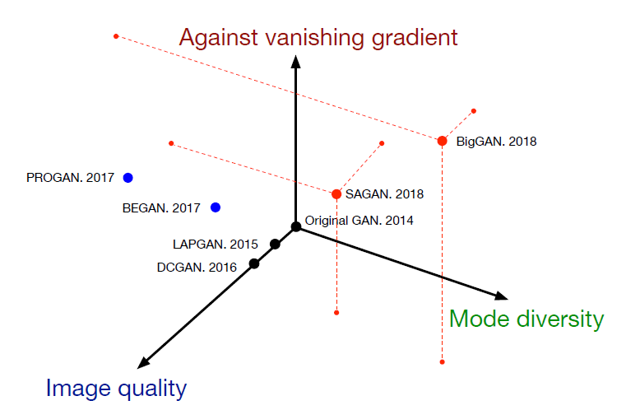
Performance of Architecture-variant GANS

Slide 11
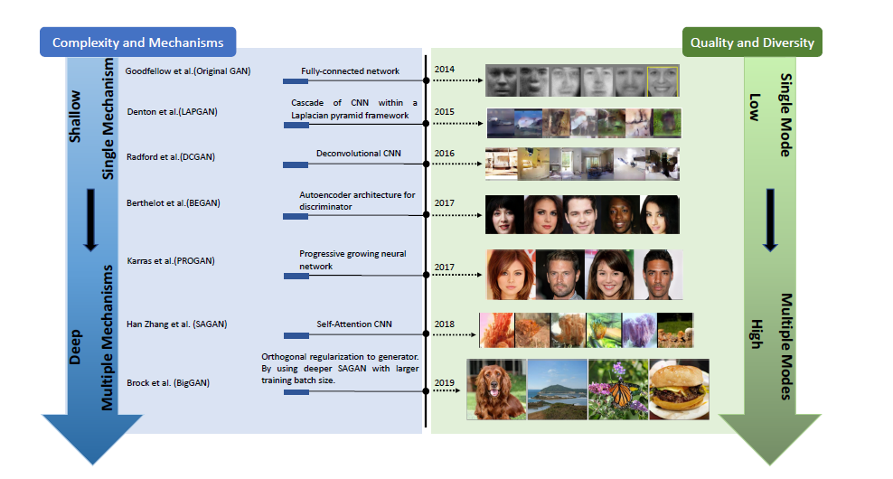
Architectural variant GAN comparison

Slide 12
Summary of architecture-variants
All proposed architecture-variants are able to improve image quality.
SAGAN is proposed for improving the capacity of multi-class learning in GANs, to produce more diverse images
PROGAN and BigGAN are able to produce high resolution images
SAGAN and BigGAN is effective for the vanishing gradient challenge

Slide 13
Loss – variant GANs
Wasserstein GAN (WGAN)
WGAN-GP
Least Square GAN (LSGAN)
f-GAN
Unrolled GAN (UGAN)
Loss Sensitive GAN (LS-GAN)
Mode Regularized GAN (MRGAN)
Geometric GAN
Relativistic GAN (RGAN)
Spectral normalization GAN (SN-GAN)

Slide 14
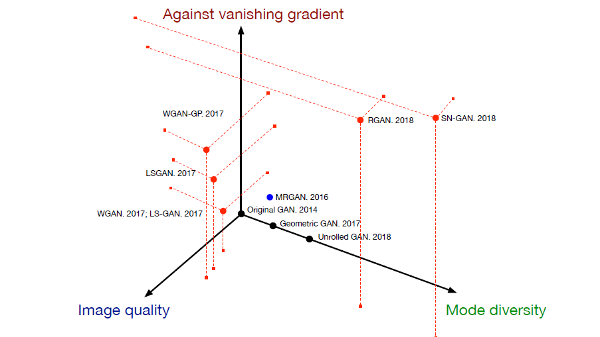
Performance of Loss – variant GANs

Slide 15
Summary of loss variants
Losses of LSGAN, RGAN and WGAN are similar to the original GAN loss
LSGAN argues that the vanishing gradient is mainly caused by the sigmoid function in the discriminator so it uses a least squares loss to optimize the GAN

Slide 16
Conclusion
Reviewed GAN-variants based on performance improvement
Stable training: improve loss functions
Image quality: progressive training in PROGRAN
Spectral Normalization has good generalization

Slide 17
Thank you

